Slide 1



TITLE
CERTIFLIX - IMAGE CORRECTNESS OF A PRODUCT IN AN E-MARKETPLACE
MEMBERS:
AJITHAA MALINI M
AZHARA Y
DEIVANAYAKI S

Slide 2



Objective
Outcome
The visual content of the product is checked for potential issues using the product identifier model, logo detector model, and text extraction.
An e-commerce website for sellers to upload quality products.
An extension that pops out during each purchase on other e-commerce sites to authenticate the product image and its content.
To develop an e-commerce website that allows sellers to upload quality product images that can be automatically authenticated by our product identifier model.
To provide a web extension API that checks the authenticity of products on other e-commerce websites.

Slide 3
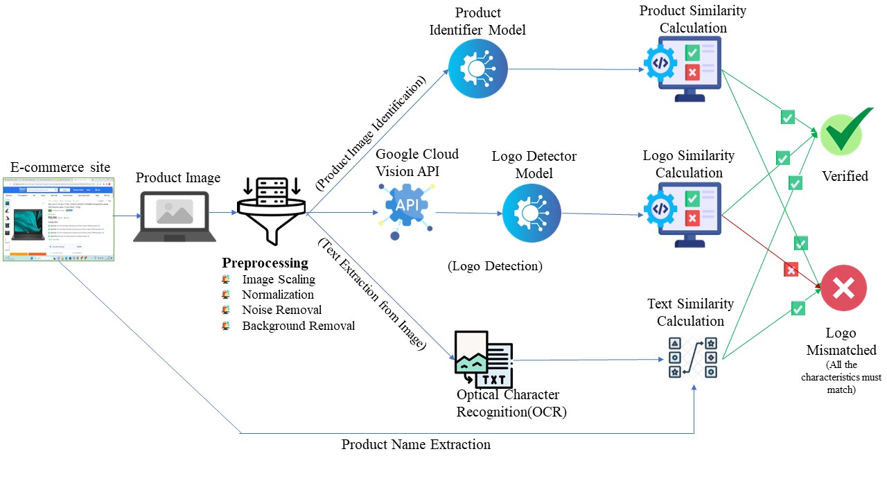
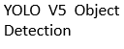

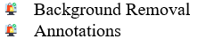
System Diagram

Slide 4
MODULES :
Product Identification
Logo Extraction & Fake Detection
Description Scrapping & Mismatch Detection
Web App for Sellers
Extension API

Slide 5
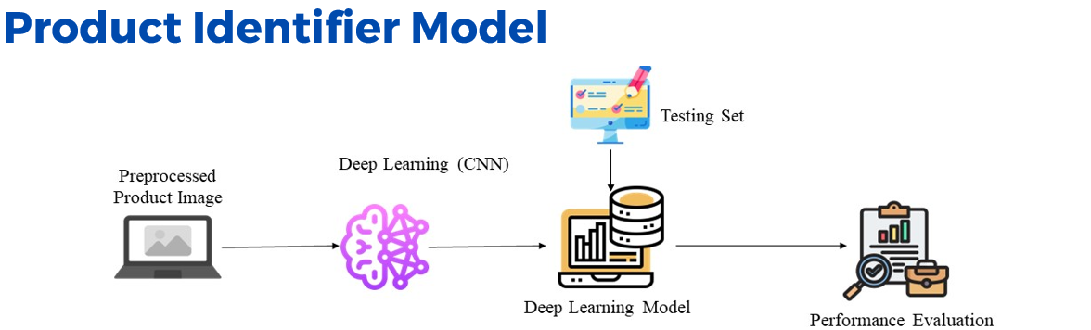
In Product Identifier model , once the image is uploaded in the website the name of the product will be displayed.
It uses the CNN variant pretrained model.
Accuracy : 98.85%

Slide 6
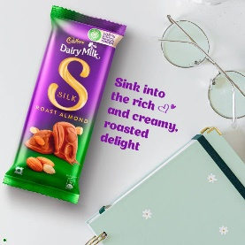

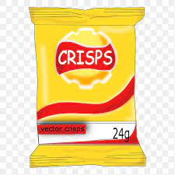

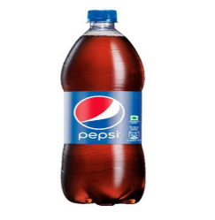
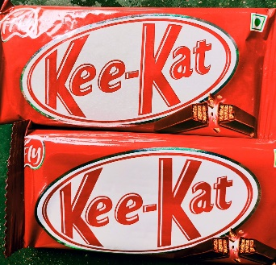
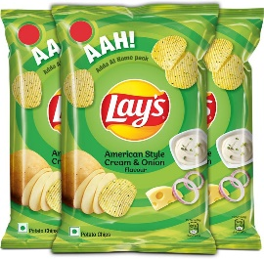
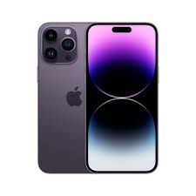
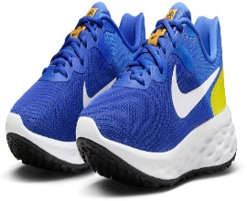
PRODUCT MODEL RESULT :
OUTLIERS :
CADBURY
LAYS
LAYS
PEPSI
KITKAT
IPHONE
NOTE :
This outliers will be solved using logo detector in the next module.
NIKESHOES

Slide 7
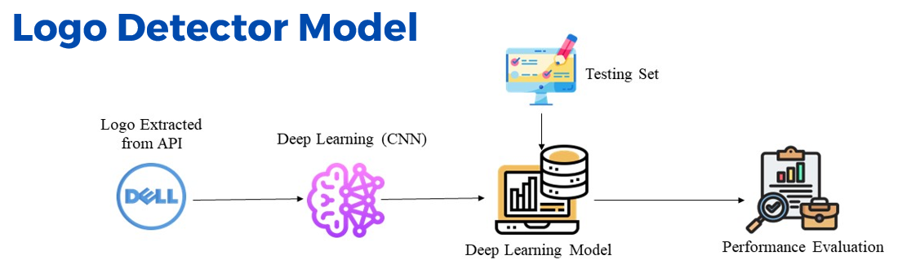
In Logo Detector Model, Logo will be extracted using YOLO V5 for object detection.
It needs the preprocessing step especially annotation for object detection.
After performing object detection again logo detector model will use MOBILE NET for predicting the correct product name.

Slide 8
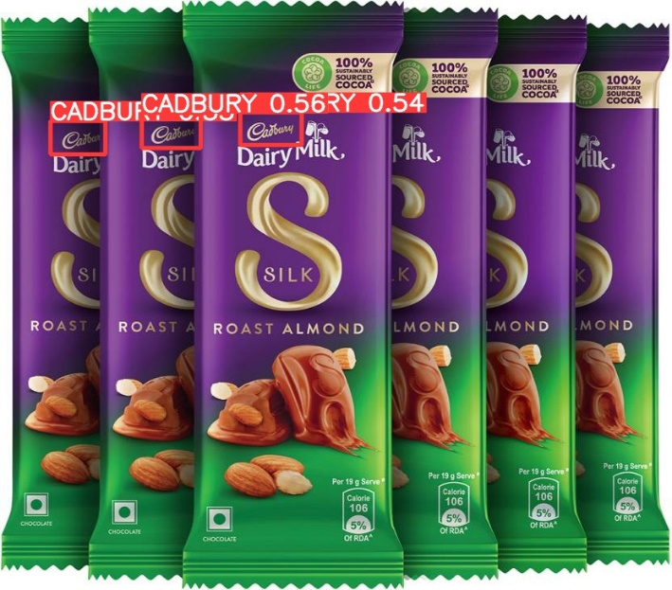
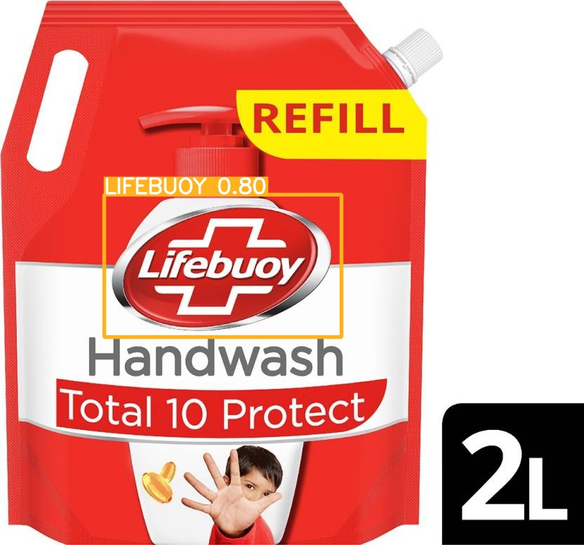
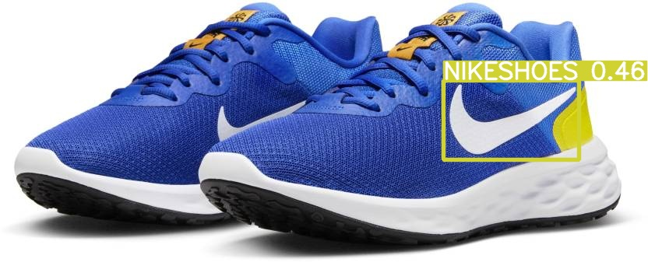
LOGO DETECTION MODEL RESULT :

Slide 9



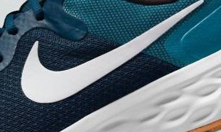
LOGO EXTRACTION MODEL RESULT :

Slide 10
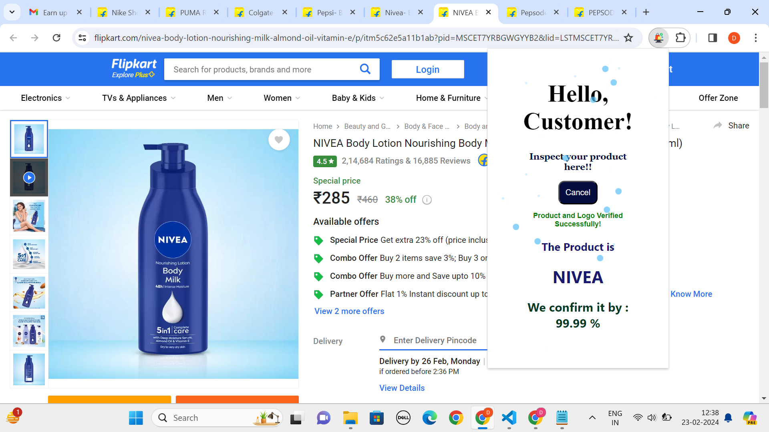
WEB EXTENSION :

Slide 11
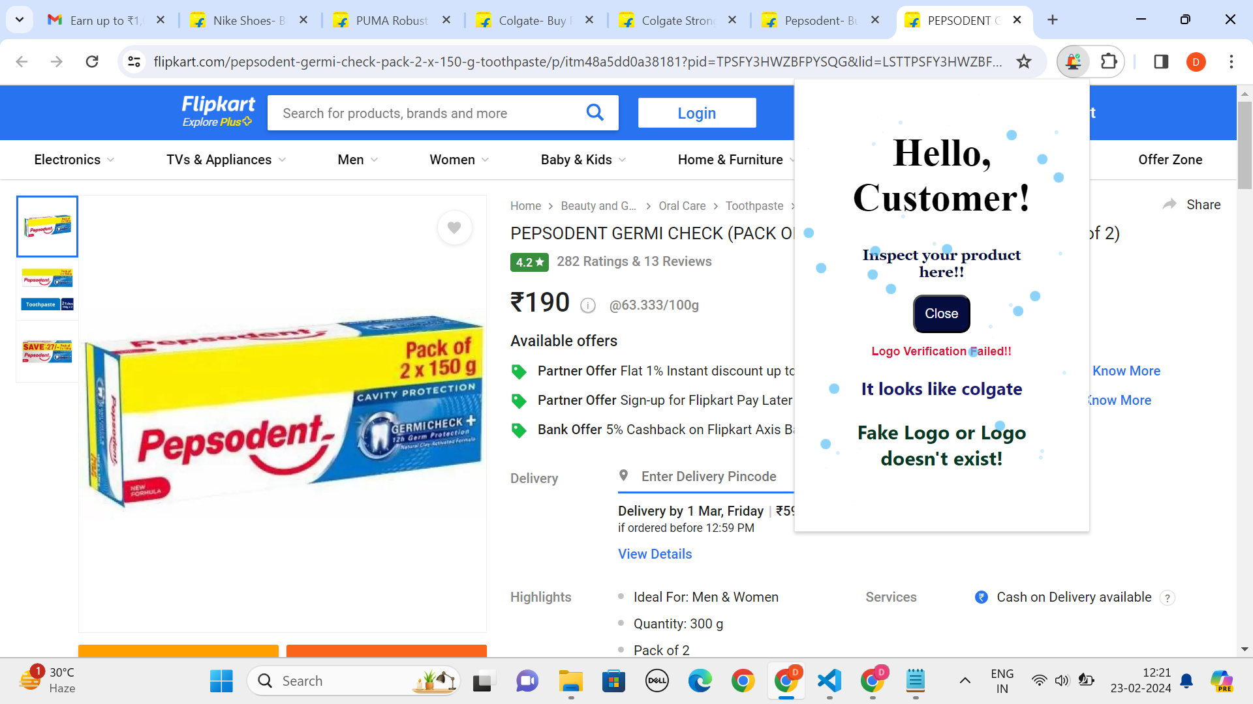
WEB EXTENSION :

Slide 12
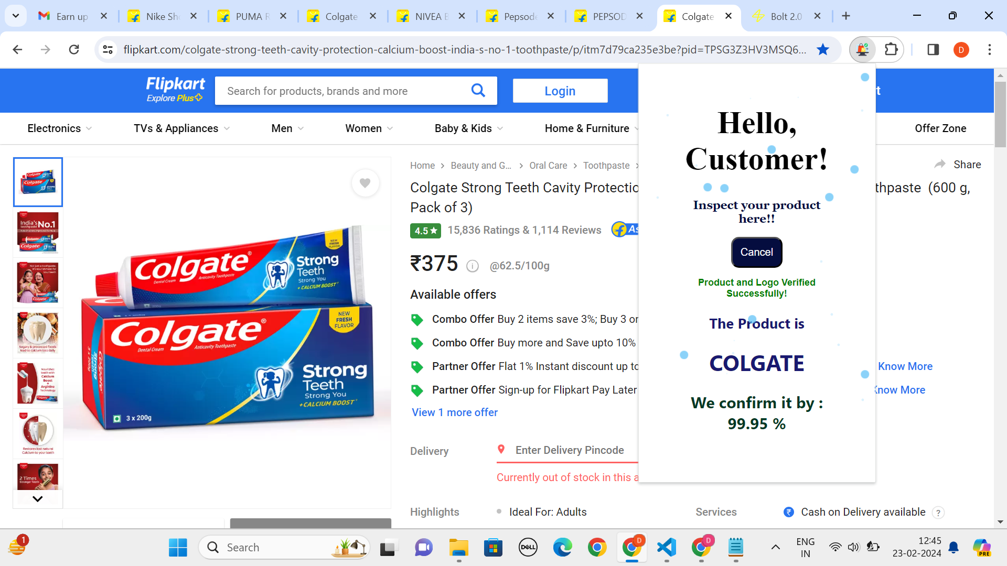
WEB EXTENSION :

Slide 13
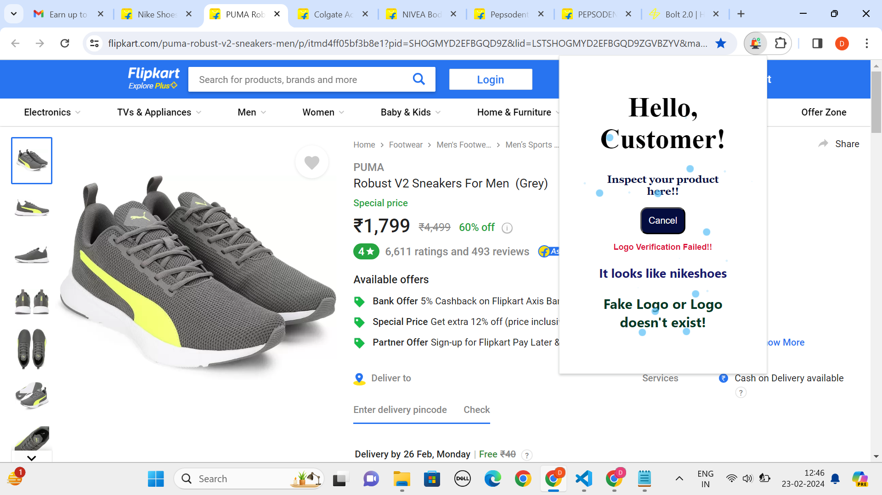
WEB EXTENSION :

Slide 14
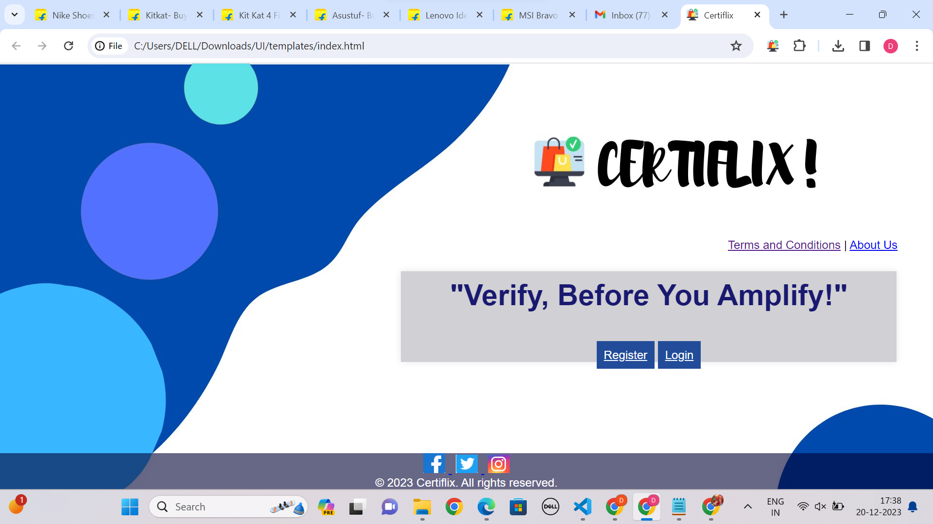
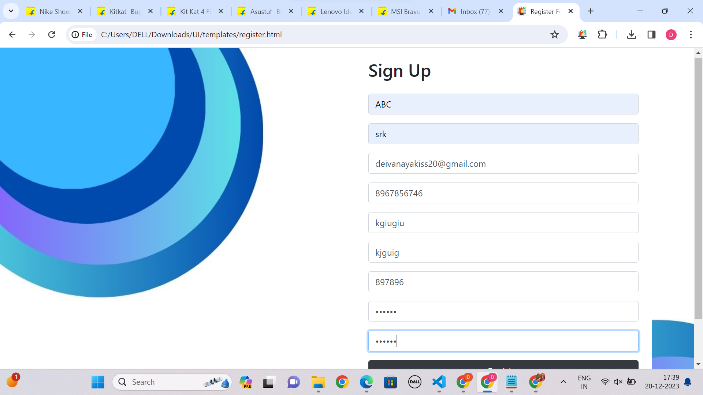
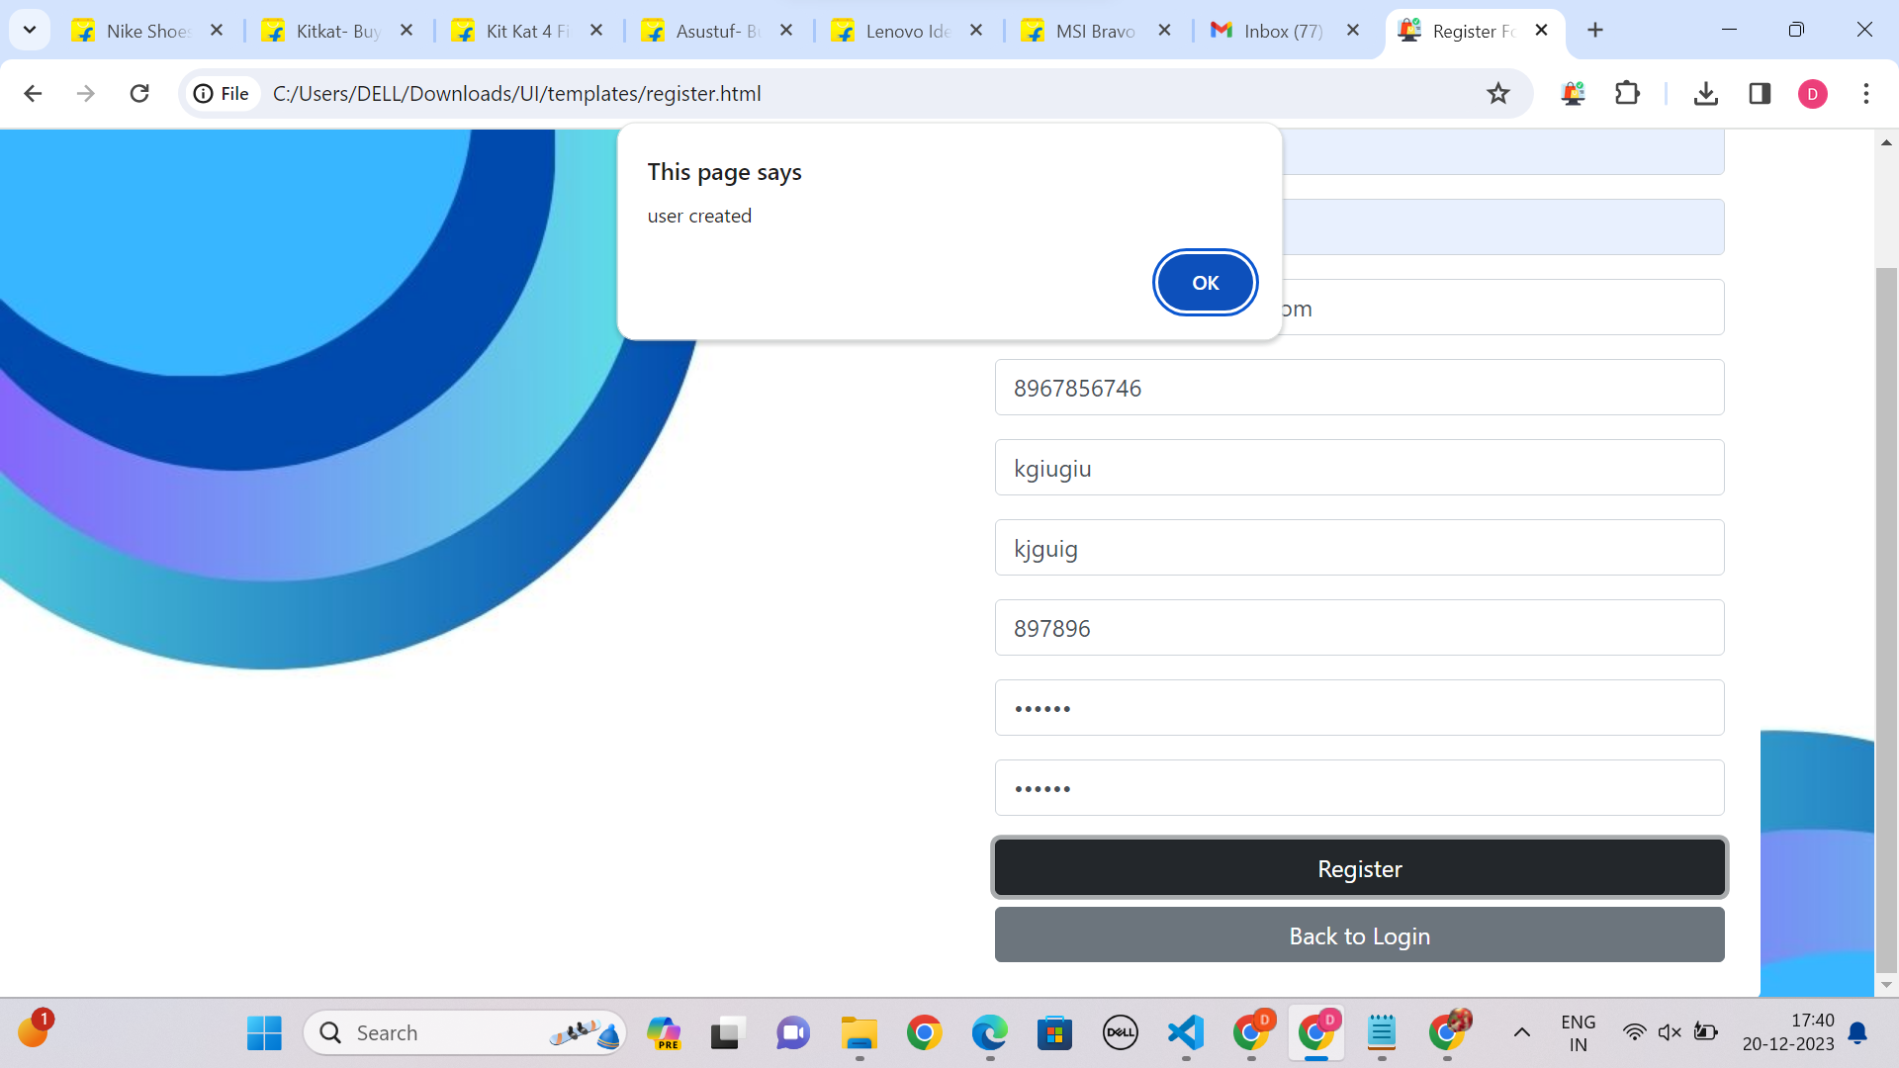
WEB APP FOR SELLERS :

Slide 15
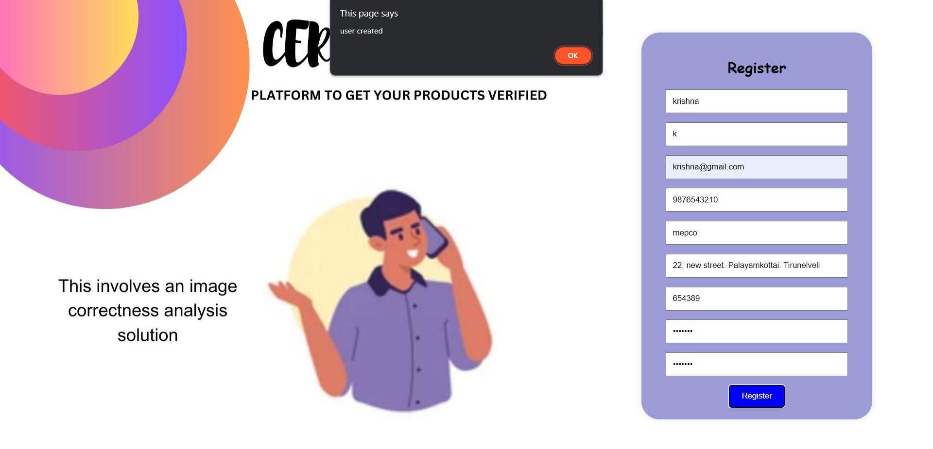
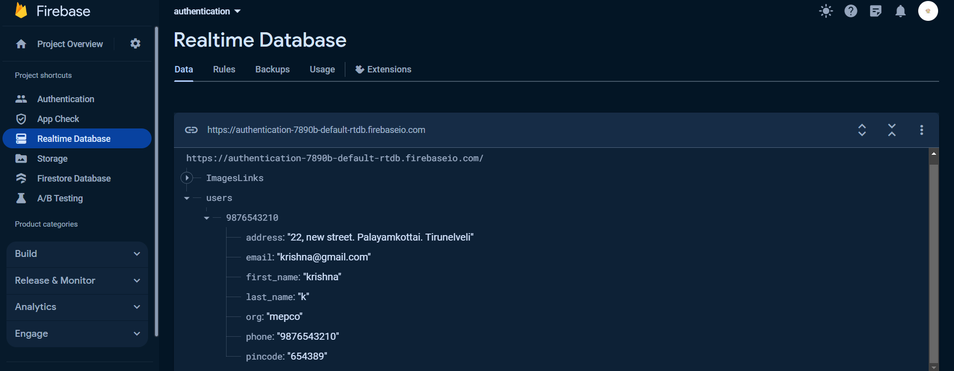
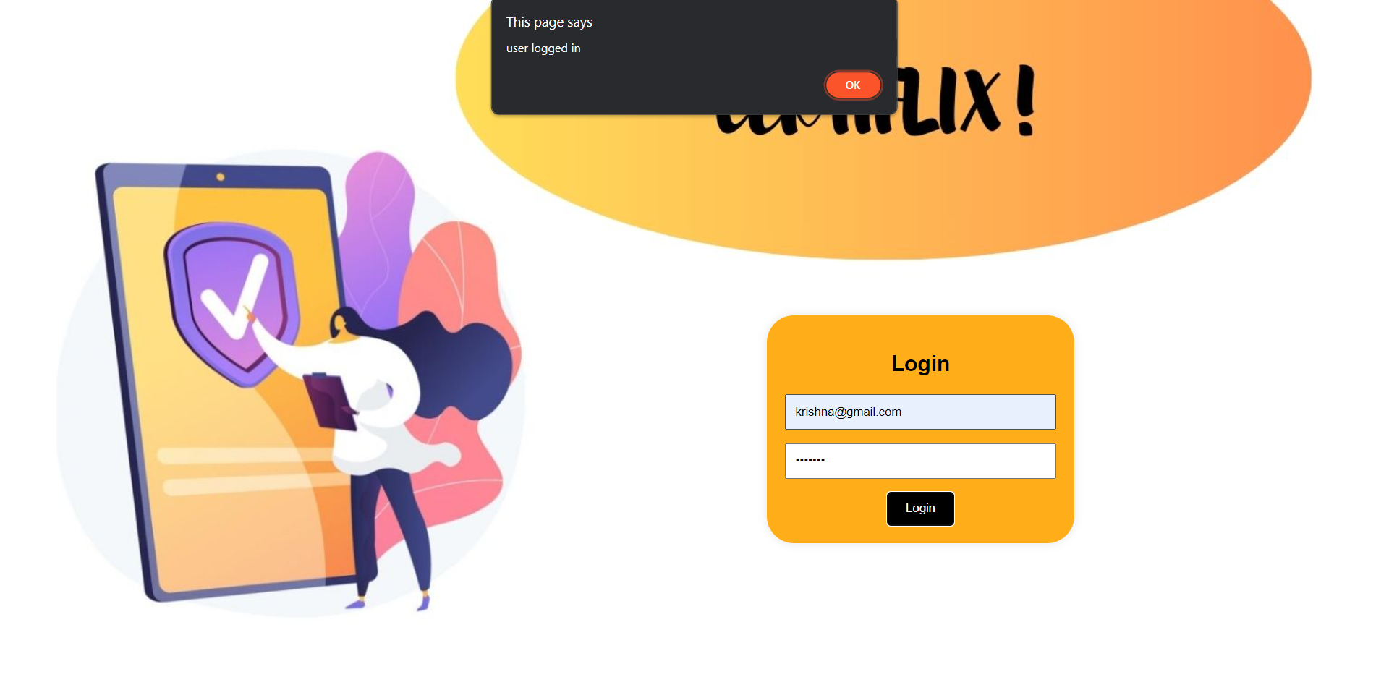
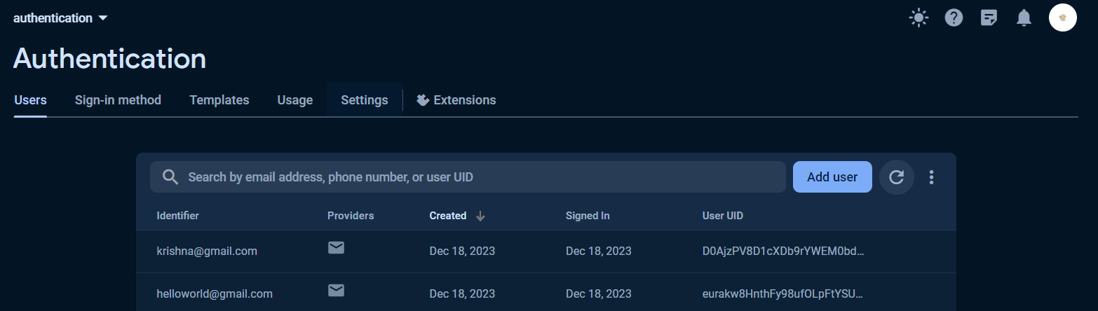
WEB APP FOR SELLERS :

Slide 16

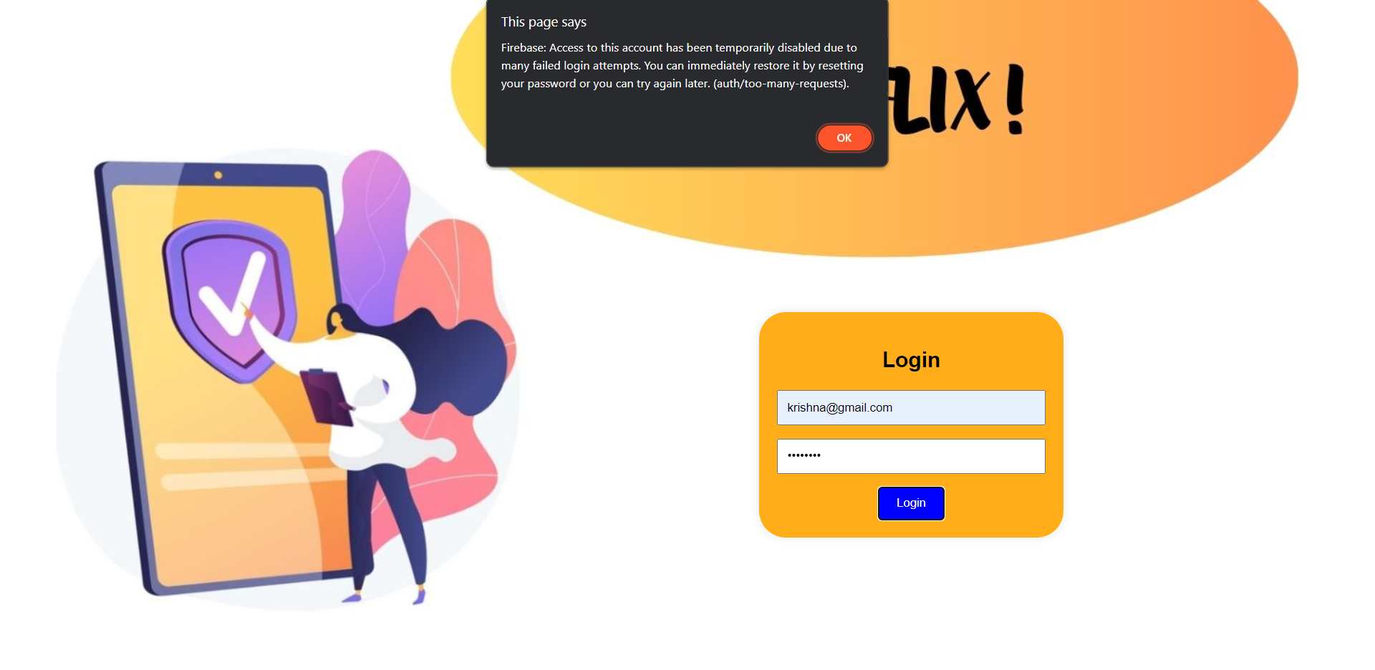
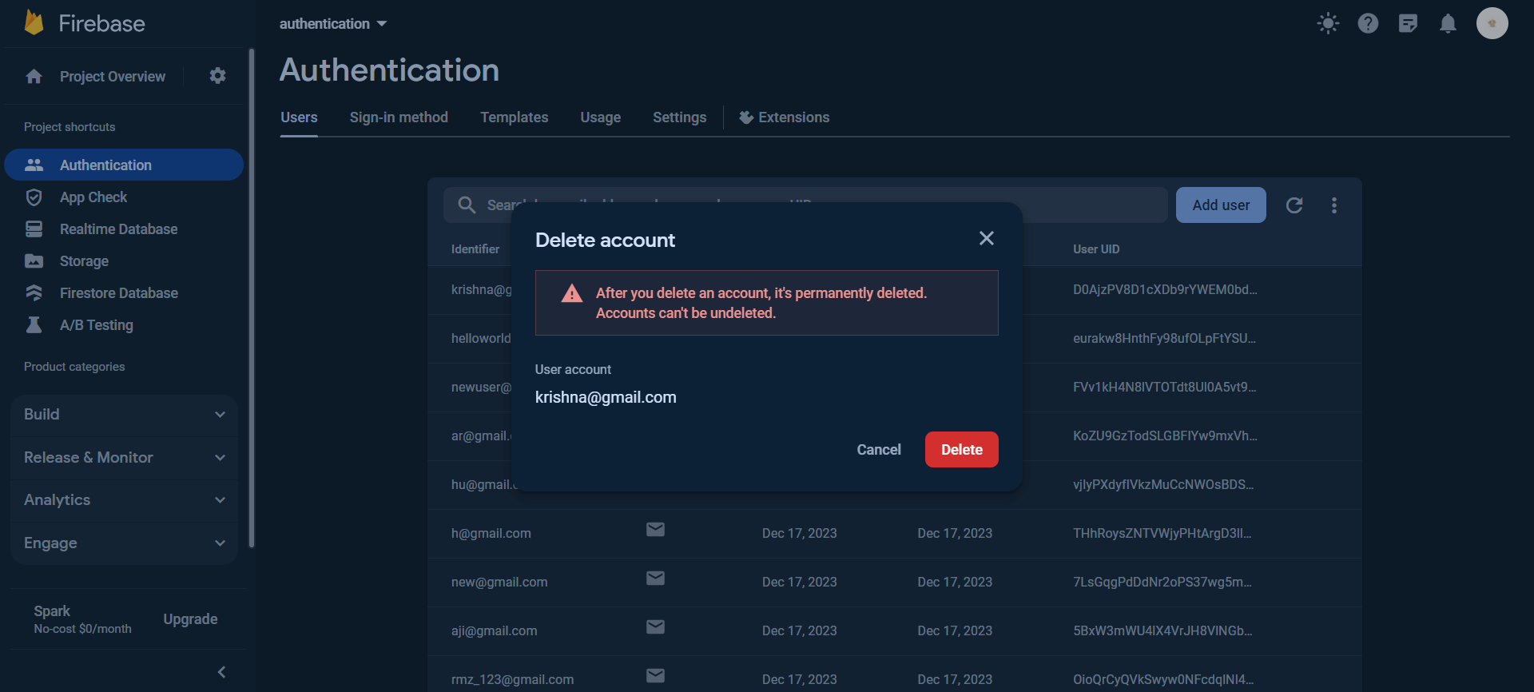
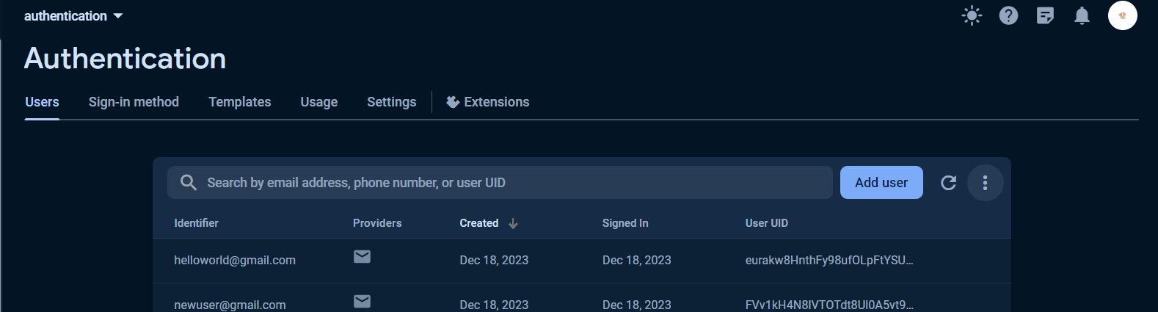
WEB APP FOR SELLERS :

Slide 17
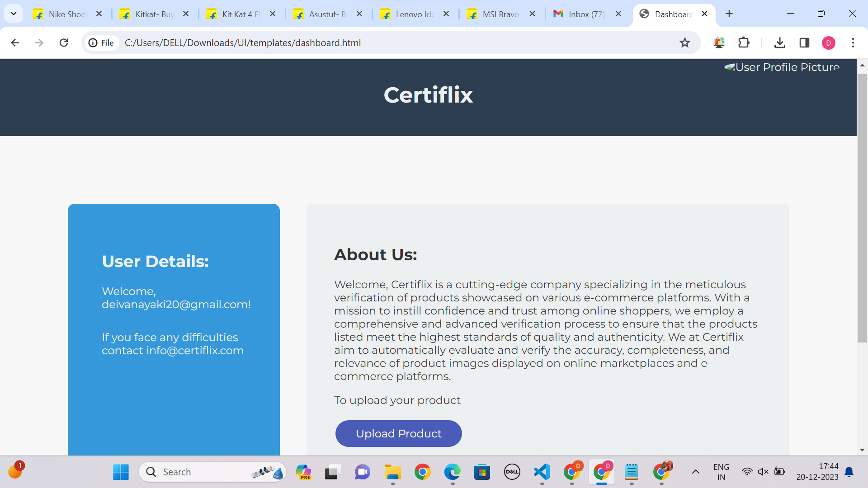
DASHBOARD PAGE:

Slide 18
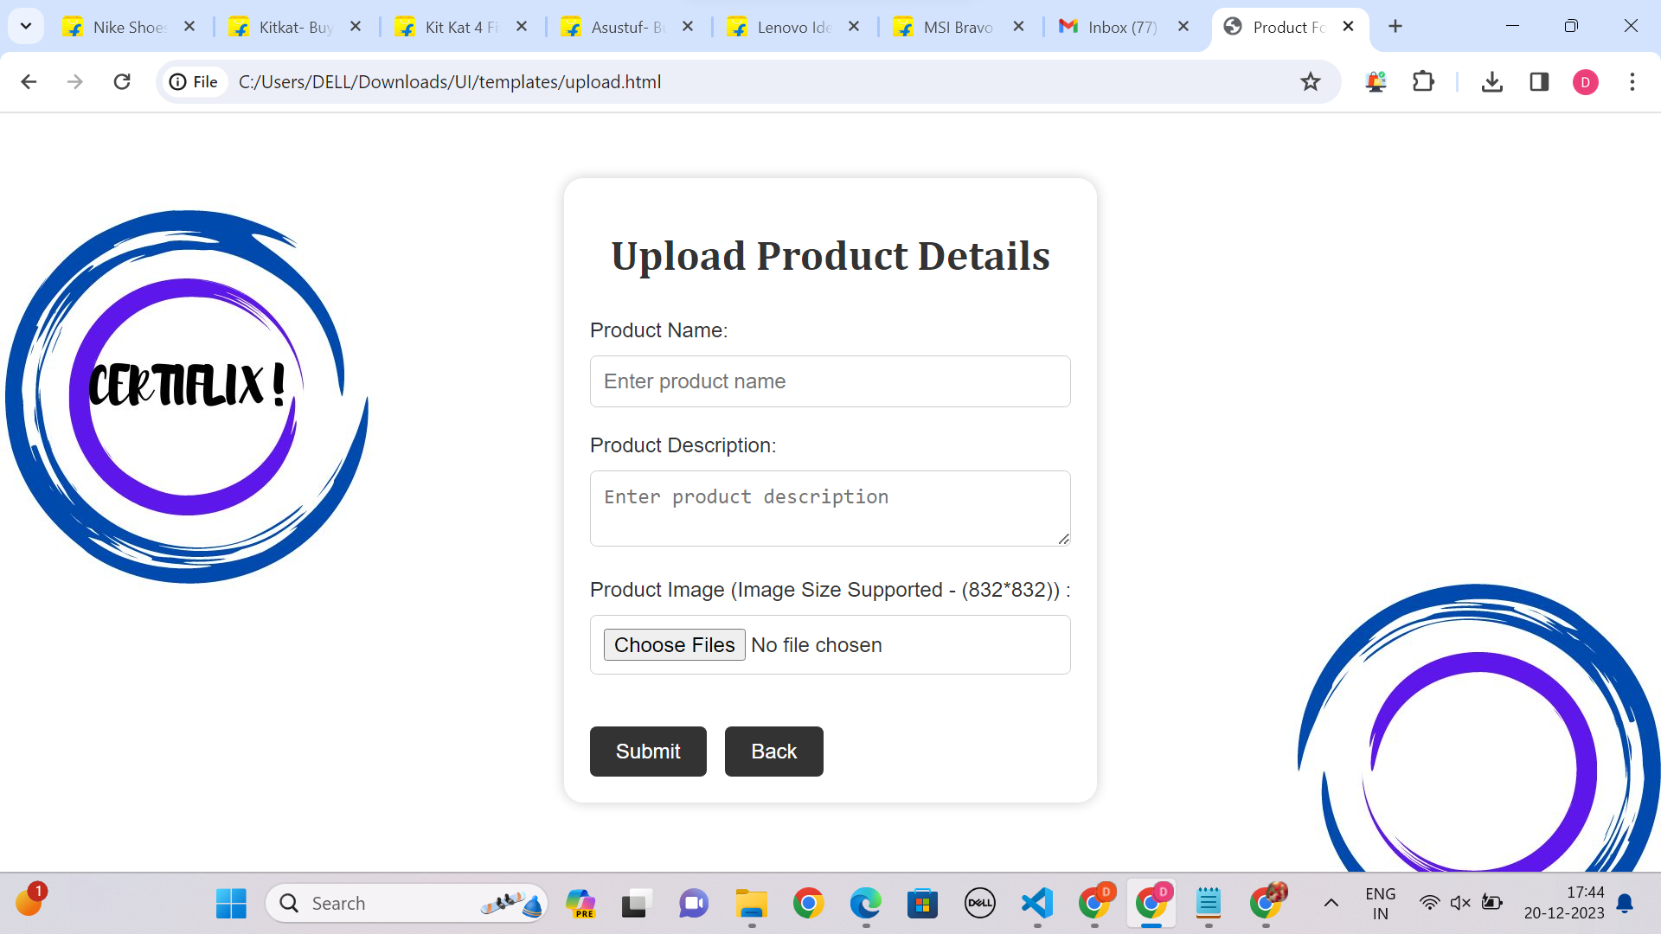
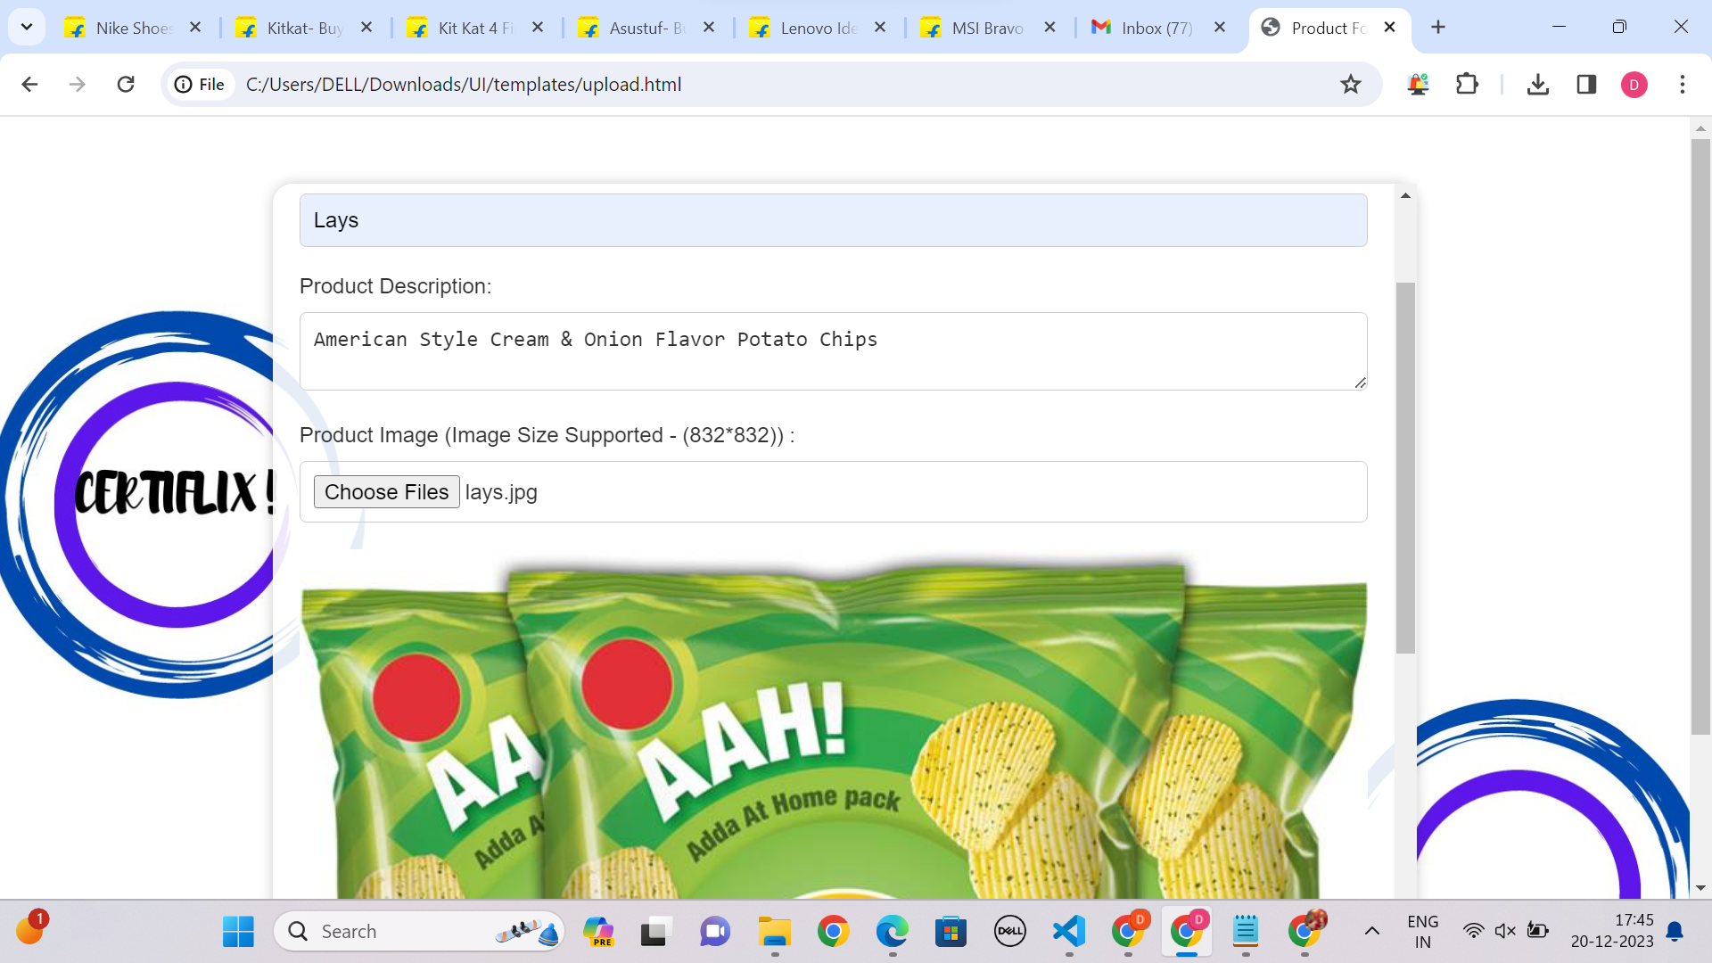
UPLOAD PAGE :

Slide 19
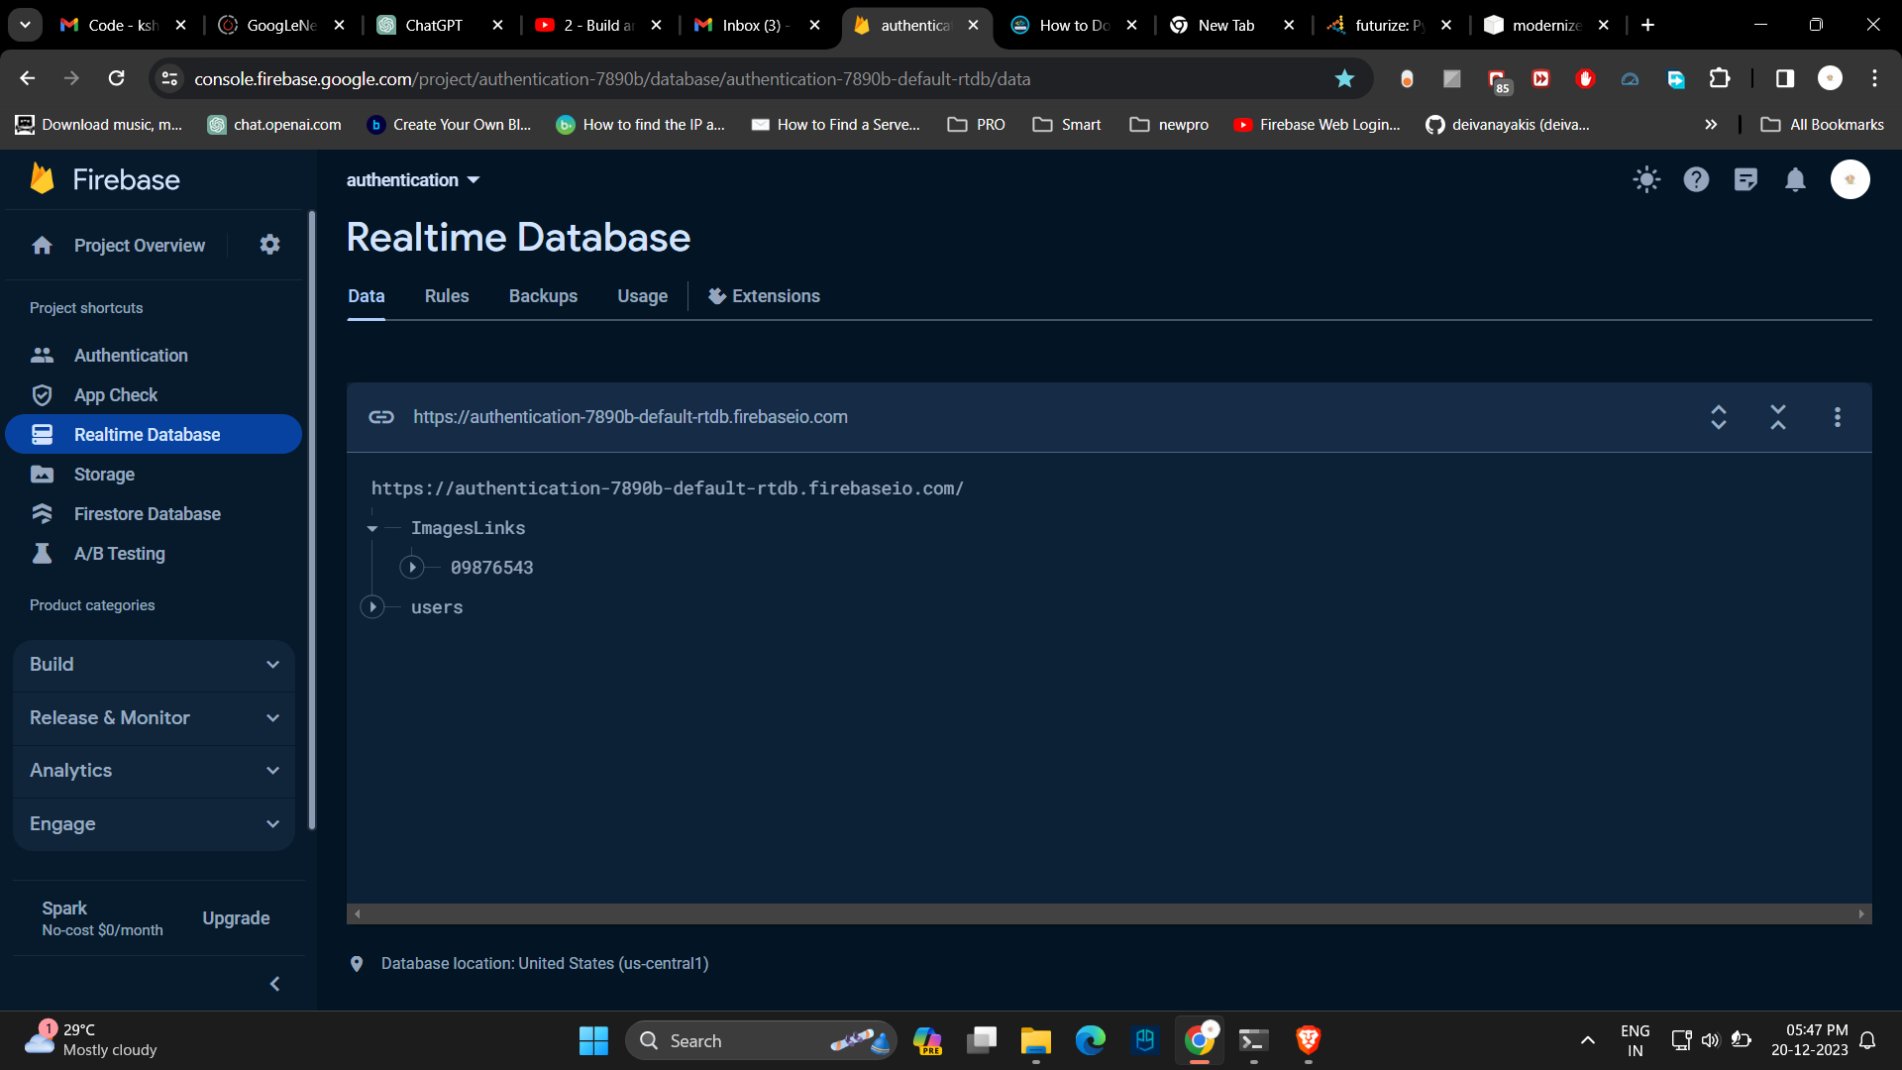
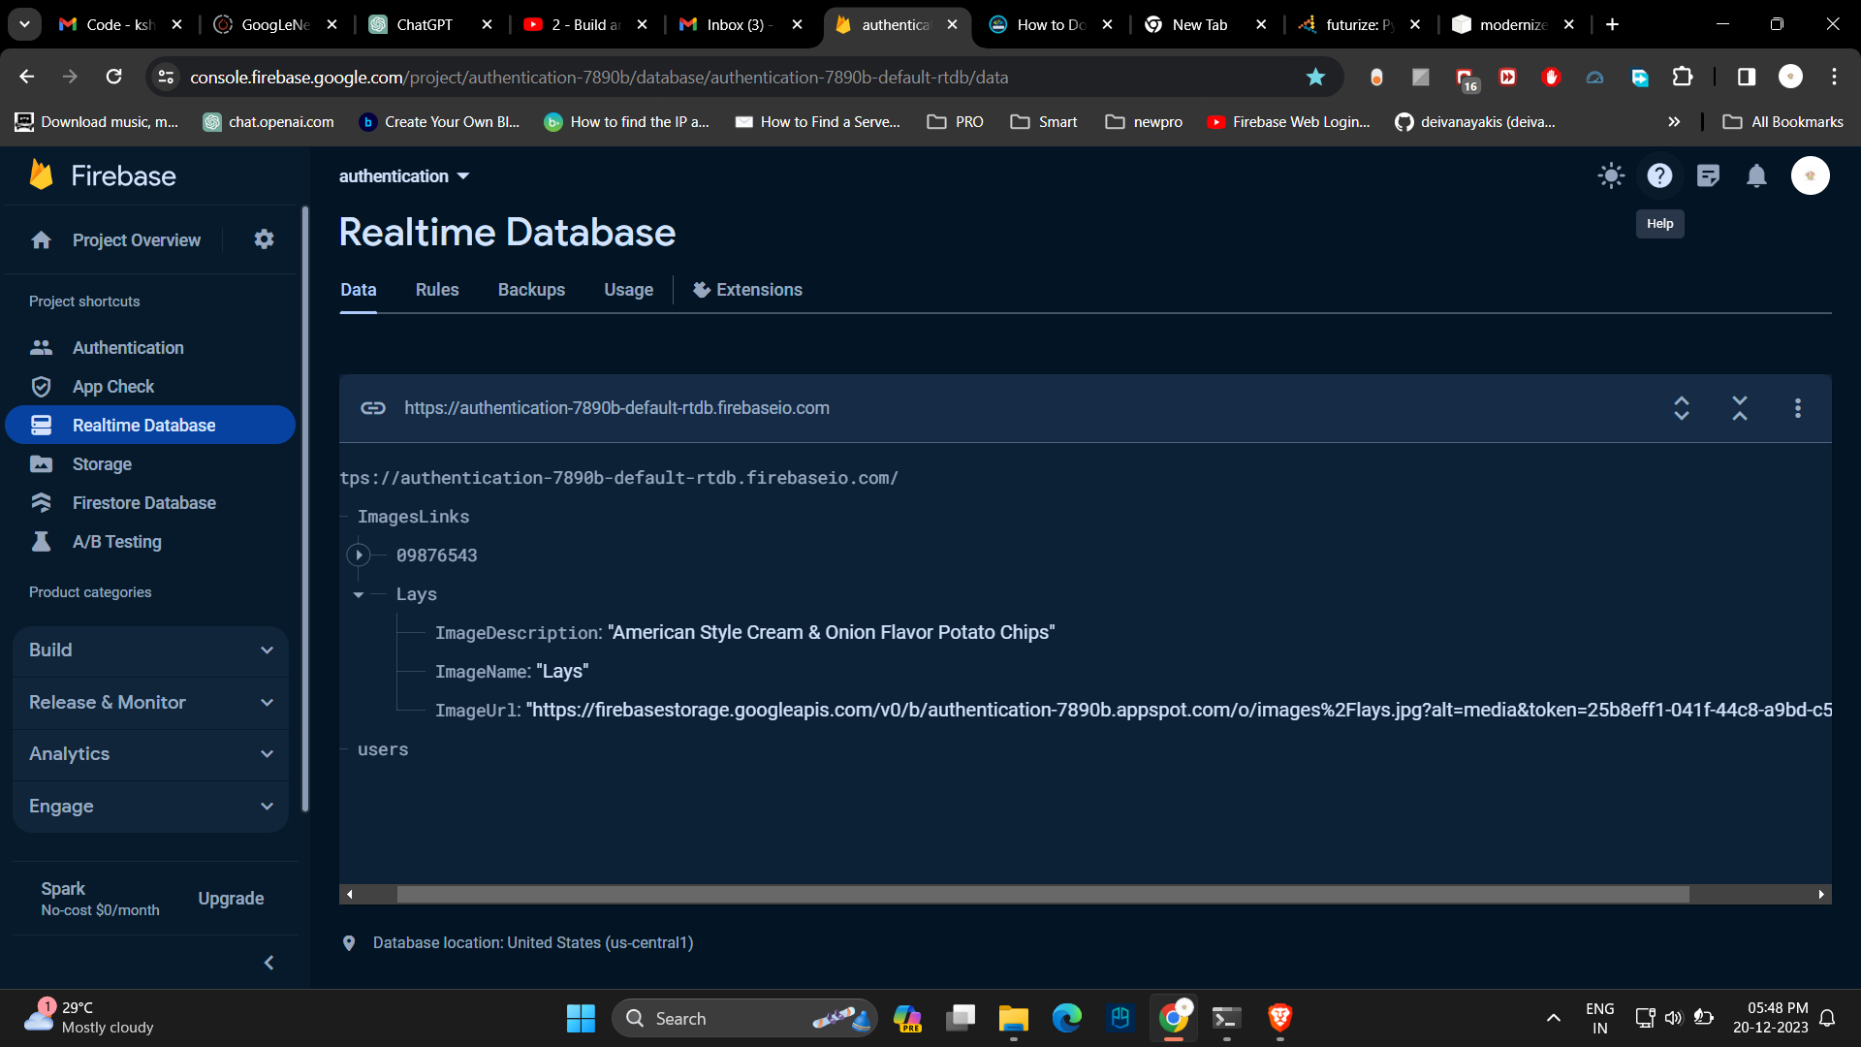
UPDATED DATABASE:

Slide 20
Innovations
Dependency Constraints
Extension support is given to the already existing websites.
Recommend the sample authenticated products when validation failure occurs.
The model requires a large dataset.
Requires considerable computation power for training the model only.

Slide 21







Technology Used
Language : HTML, CSS, JavaScript ,Python
Framework : Flask
IDE : Visual Studio
Library : Tensorflow
DataBase : FireBase

